Slide 1
Modern Georgia
Mr. Rockwell
8th Grade Georgia Studies

Slide 2
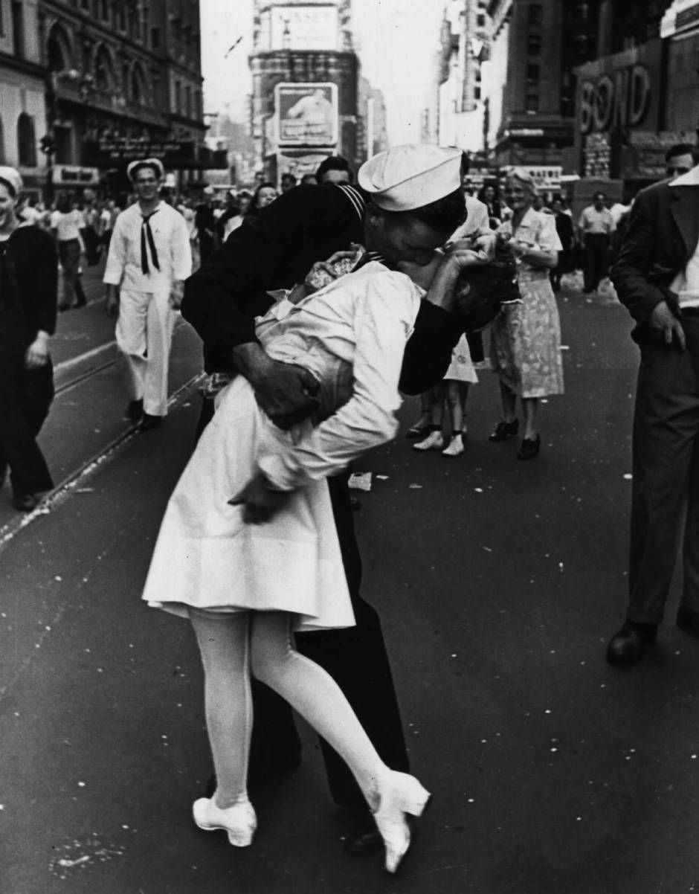
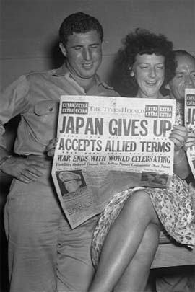
1. End of WWII
Following the end of WWII less people worked in agriculture due to the significant increase of industry during the war.

Slide 3
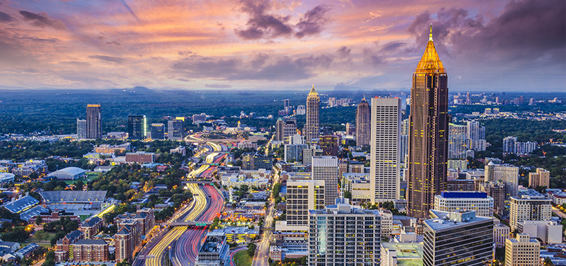
2. Atlanta in 2016
In 2016, the city of Atlanta remains the financial, communication, and transportation center for the Southeastern United States.

Slide 4
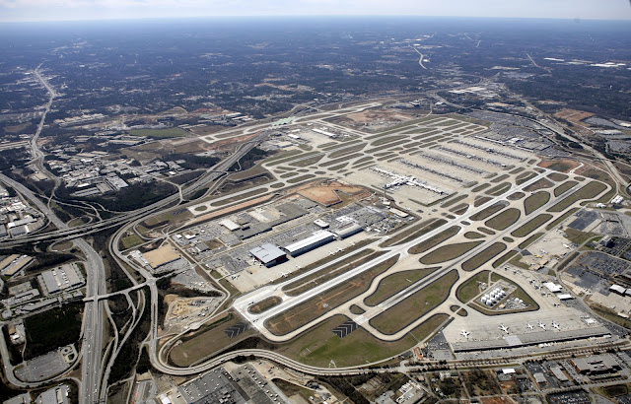
3. William Hartsfield
Six term Atlanta mayor, William Hartsfield, is most remembered for his work with aviation. The airport is named after him.

Slide 5
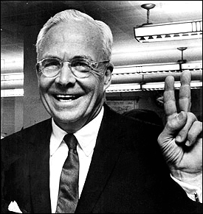
4. Ivan Allen Jr.
Atlanta mayor Ivan Allen Jr. accomplished the following while in office:
Integrated city government and fire departments
Removed “colored” and “white” signs in City Hall
Brought professional sports to Atlanta

Slide 6
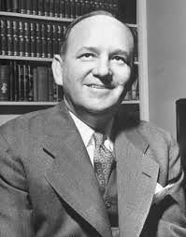
5. Ellis Arnall
During Governor Ellis Arnall’s four year term, he was able to accomplish the following:
Abolished the poll tax
Corrected the educational problems of Eugene Talmadge’s term
Granted 18 year olds the right to vote
Established a new state constitution in 1945

Slide 7
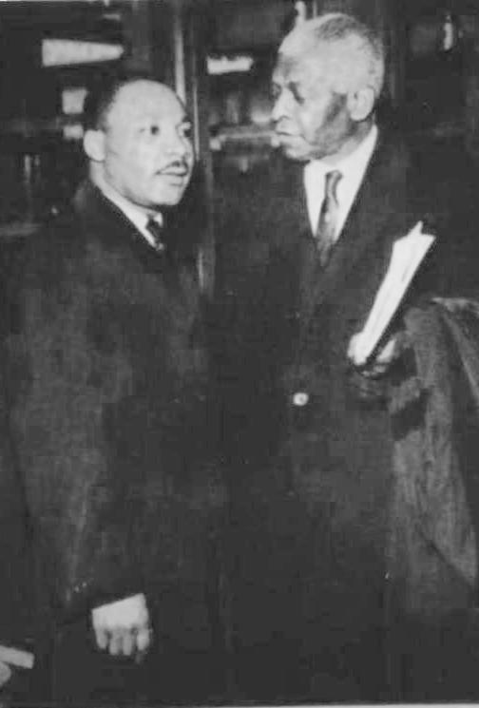
6. Benjamin Mays
Benjamin Mays was a college professor and served as a mentor to Martin Luther King Jr.

Slide 8
7. White Primary System
Under the white primary system, only whites were allowed to vote in primary elections. In 1946, the white primaries were ruled unconstitutional.

Slide 9
8. 1946 Governor’s Race
The 1946 Governor’s race saw 3 different individuals trying to run for governor. Ellis Arnall, Melvin Thompson, and Herman Talmadge all thought that they should be Georgia’s governor. In the end, Herman Talmadge was elected governor replacing his deceased dad.

Slide 10
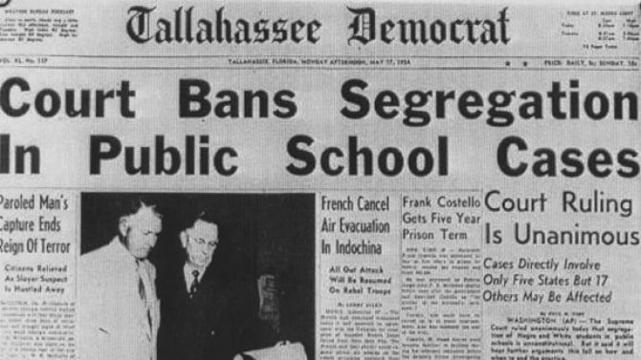
9. Brown vs. Board of Education
In 1954, the court case Brown vs. Board of Education overturned the 1896 Plessy vs. Ferguson case by claiming that “separate but equal” was unconstitutional.

Slide 11
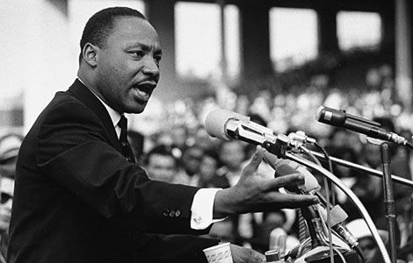
10. Martin Luther King Jr.
Martin Luther King Jr. helped lead the nation through the Civil Rights Movement of the 1950’s and 1960’s using a nonviolent approach. On April 4, 1968, Dr. King was assassinated in Memphis, Tennessee.

Slide 12
11. 1956 Georgia State Flag
The 1956 Georgia state flag was a source of controversy and division between black and whites and Georgia businessmen wanted a flag that promoted unity and welcomed tourists.

Slide 13
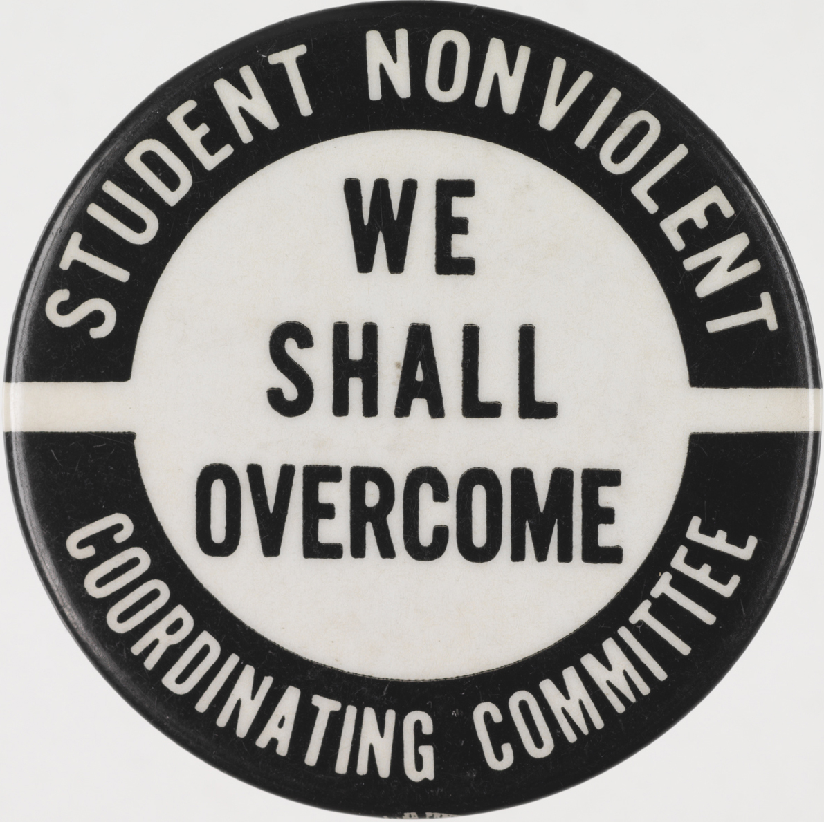
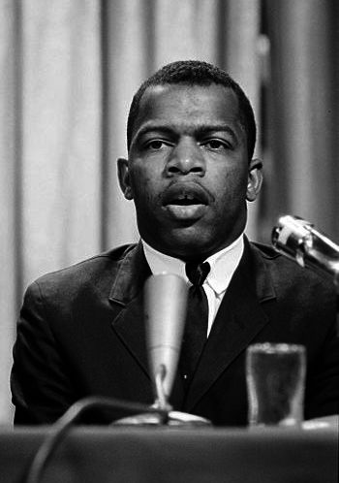
12. Student Non-Violent Coordinating Committee (SNICK)
In 1960, a new organization called the Student Non-Violent Coordinating Committee or (SNICK) led peaceful protests, sit-ins at lunch counters, and boycotts of businesses that would not serve blacks. John Lewis was their first president.

Slide 14
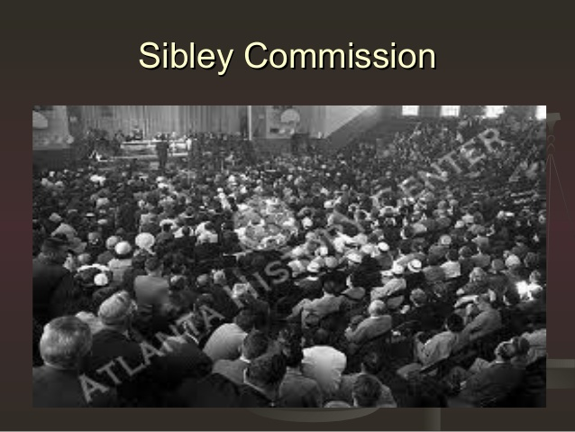
13. Sibley Commission
Due to many school systems in Georgia refusing to desegregate public schools, the Sibley Commission was created. Its purpose was to study the problem of school integration. The Sibley Commission recommended allowing local school systems to decide if they wanted integration.

Slide 15
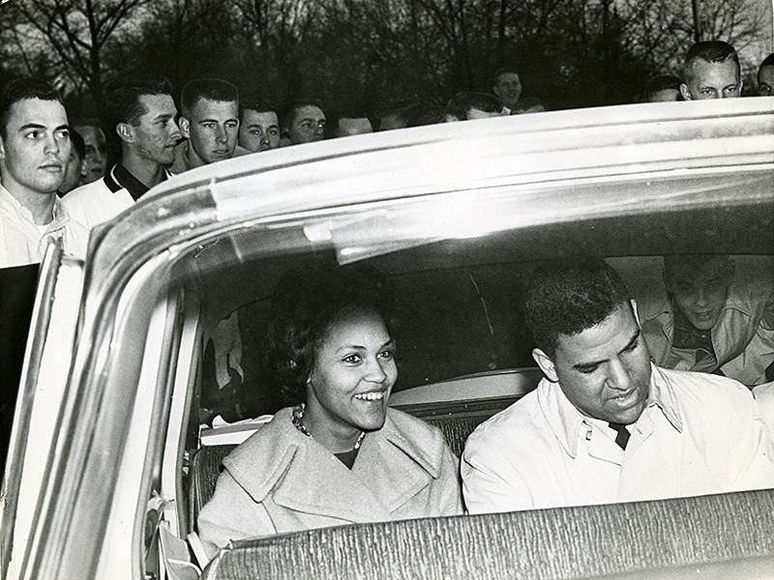
14. Charlayne Hunter
In 1961, Charlayne Hunter and Hamilton Holmes became the first black male and female to attend UGA.

Slide 16
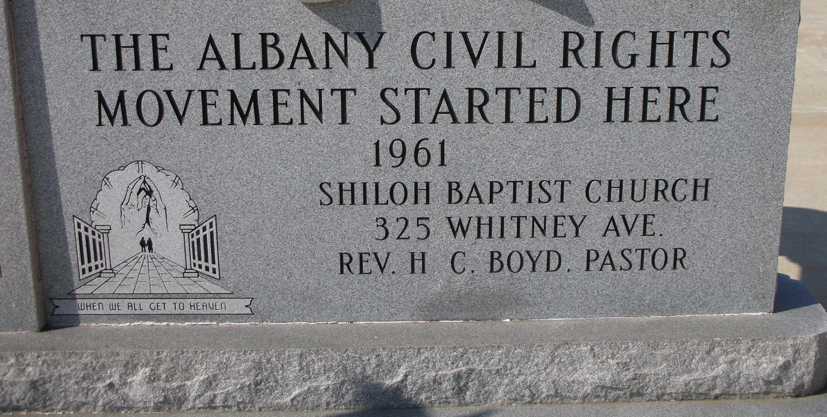
15. Albany Movement
The main focus of the Albany Movement was to integrate interstate bus station waiting rooms in Albany.

Slide 17
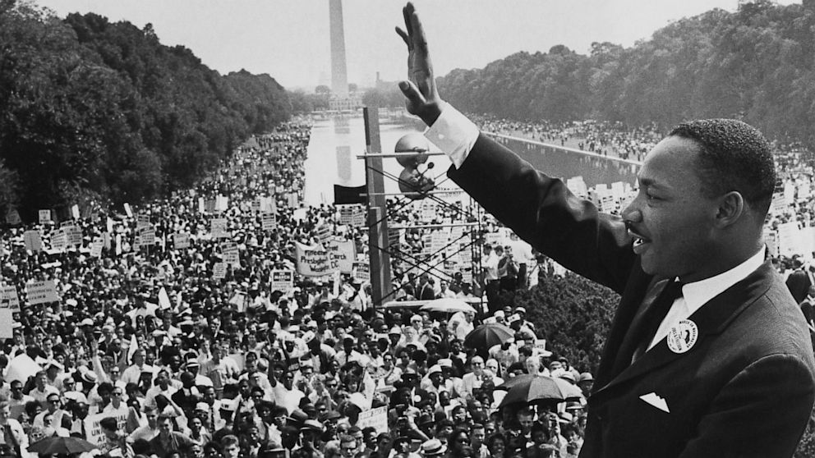
16. March on Washington
The March on Washington in 1963 is where MLK delivered his famous “I Have a Dream” speech.

Slide 18
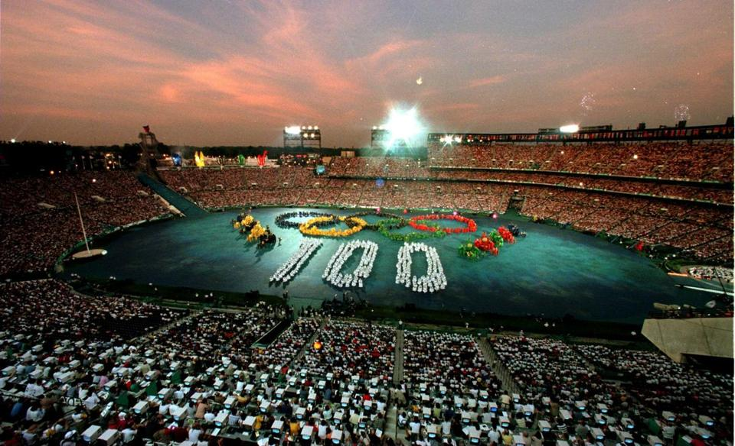
17. Maynard Jackson
Atlanta’s first African American mayor, Maynard Jackson, helped expand the airport, led the development of MARTA, and was responsible for bringing the 1996 Olympics to Atlanta.

Slide 19
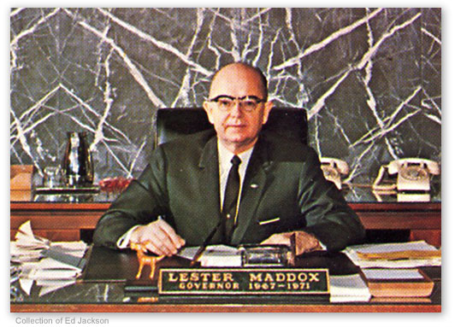
18. Lester Maddox
In 1967, Lester Maddox shocked many by appointing more African Americans to state boards than all prior governors combined. He held “People’s Days” twice a month.

Slide 20
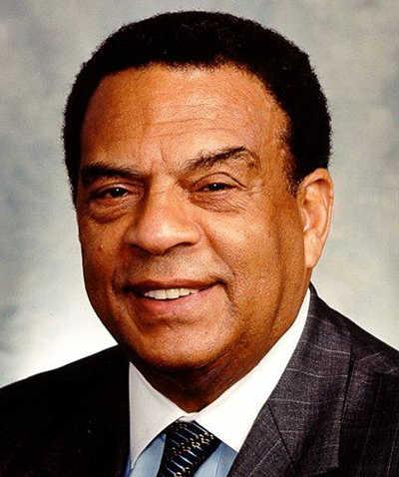
19. Andrew Young
Andrew Young established “citizenship schools” which taught nonviolent organizing strategies to potential black leaders.

Slide 21
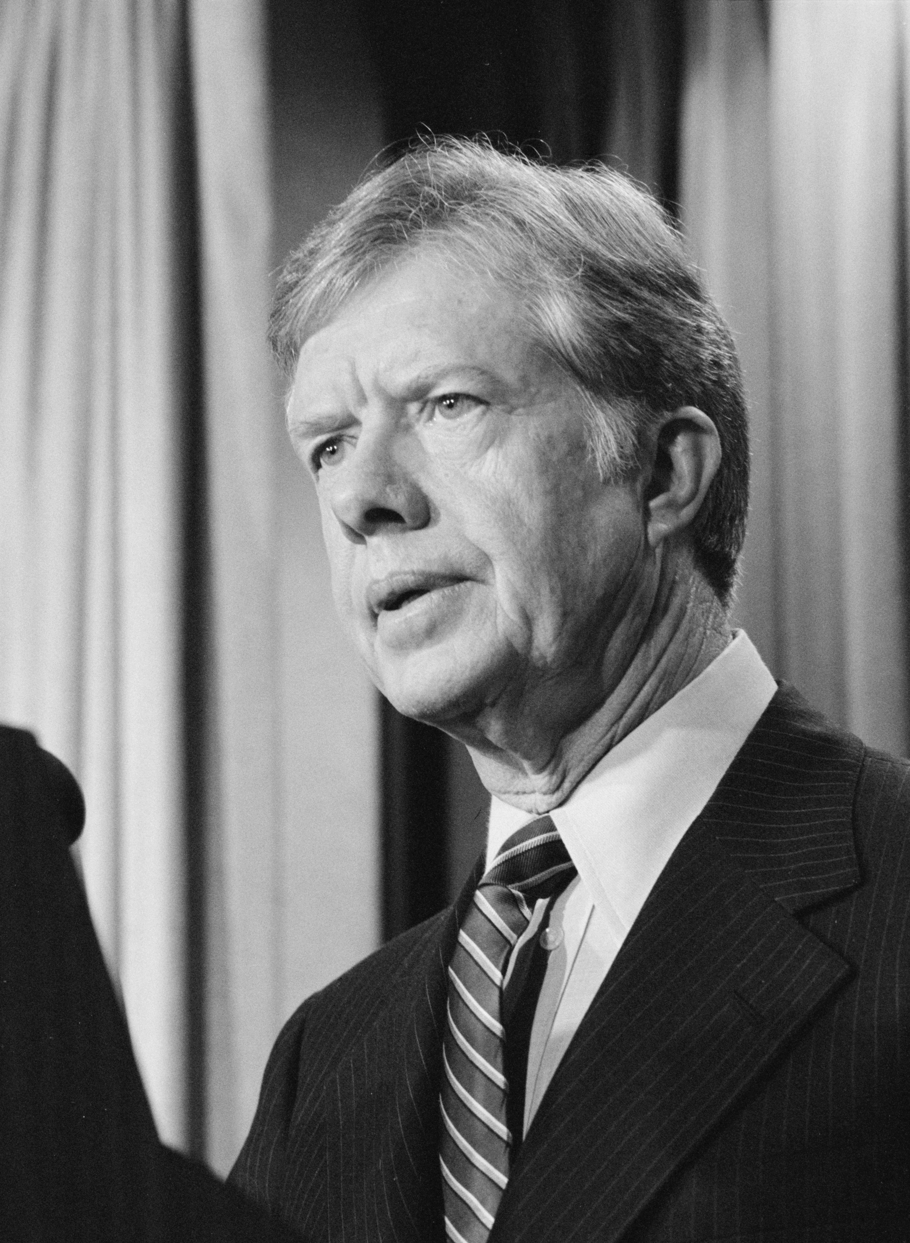
20. Jimmy Carter
Jimmy Carter, the 39th president, helped establish better relations with China, started Habitat for Humanity, created the Department of Education, ratified the Panama Canal treaties, and helped with the Camp David Peace Accords.

Slide 22
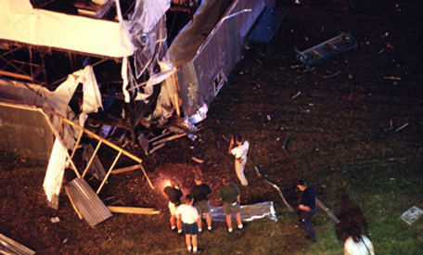
21. 1996 Olympics
The 1996 Olympics brought millions of dollars and international recognition to the city of Atlanta. There was also a bomb set off at Centennial Park killing one person.

